Slide 1
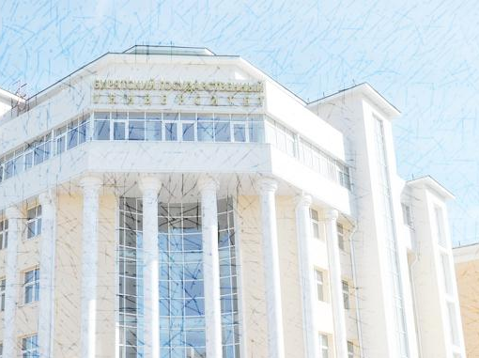


INSTITUTE OF PHILOLOGY, FOREIGN LANGUAGES AND MASS COMMUNICATIONS
DEPARTMENT OF RUSSIAN AS A FOREIGN LANGUAGE
bsu.kafedra_rki@mail.ru

Slide 2
Today the Department of Russian as a Foreign Language implements the following activities:
training of foreign citizens for admission to Russian universities - programs of initial pre-university education,
university Russian language training of foreign students at the main faculties / institutes,
training of foreign citizens for the master's program "Russian as a Foreign Language",

Slide 3
Today the Department of Russian as a Foreign Language implements the following activities:
included training of foreign students from partner universities of BSU (language internships),
training of foreign citizens in language courses of various duration, intensity and focus,
training for testing (TORFL-1, TORFL-2, TORFL-3, comprehensive test for migrants),

Slide 4
Today the Department of Russian as a Foreign Language implements the following activities:
-organization of the Winter and Summer School of the Russian Language for foreign students.

Slide 5
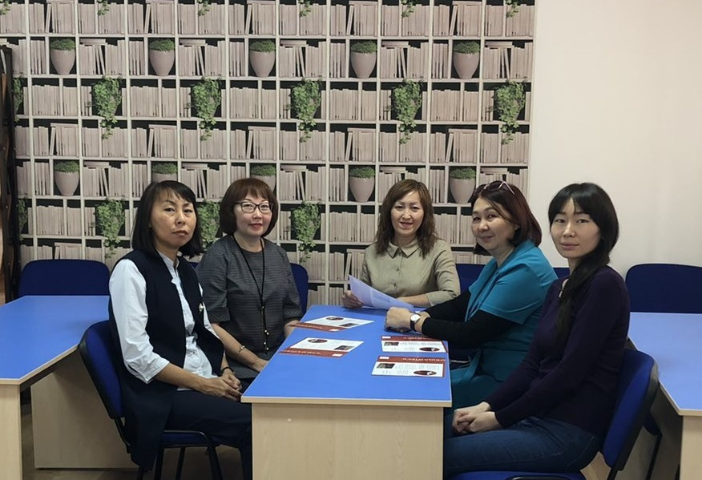
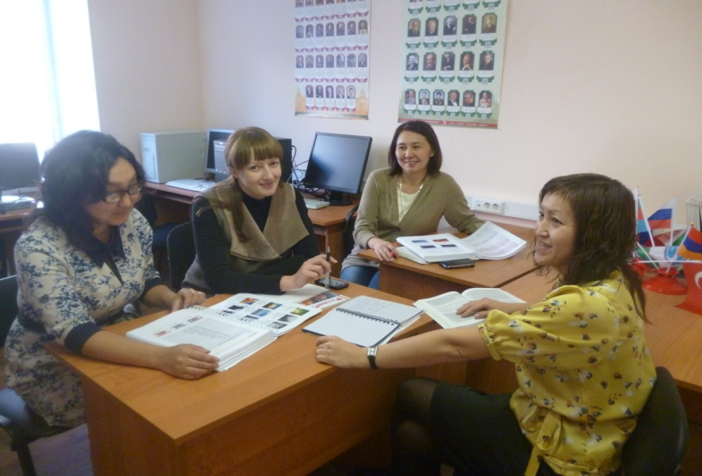
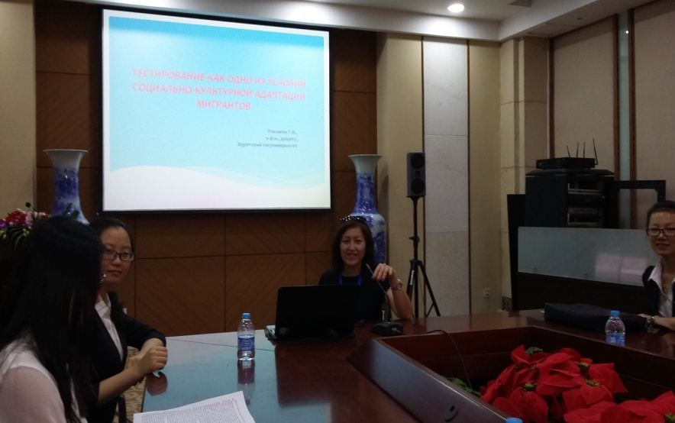

Slide 6
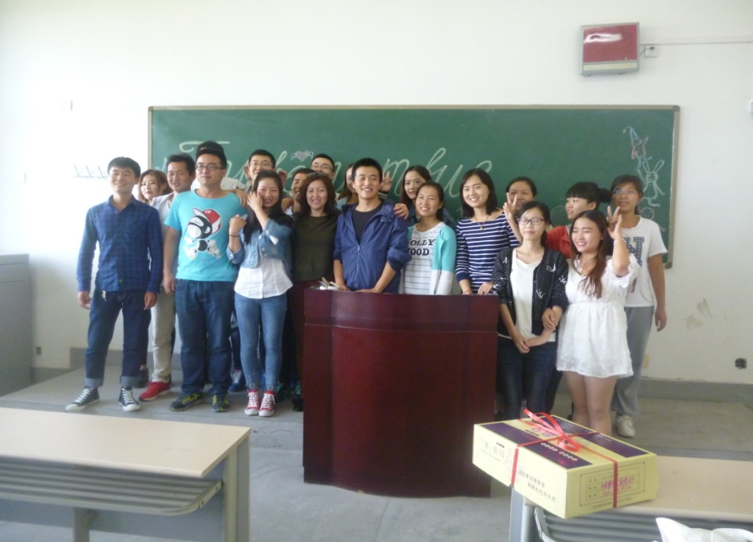
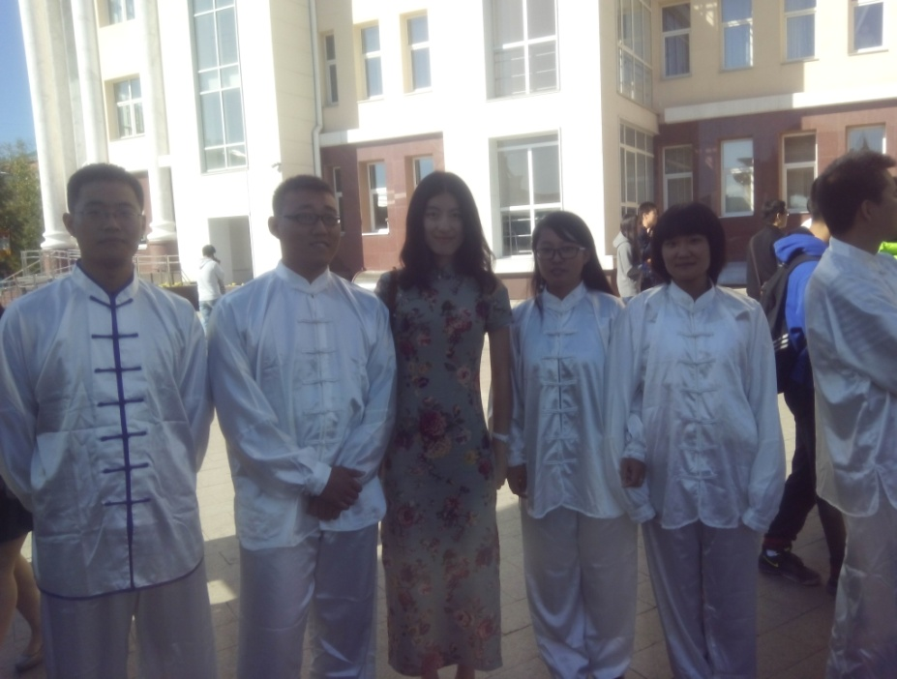
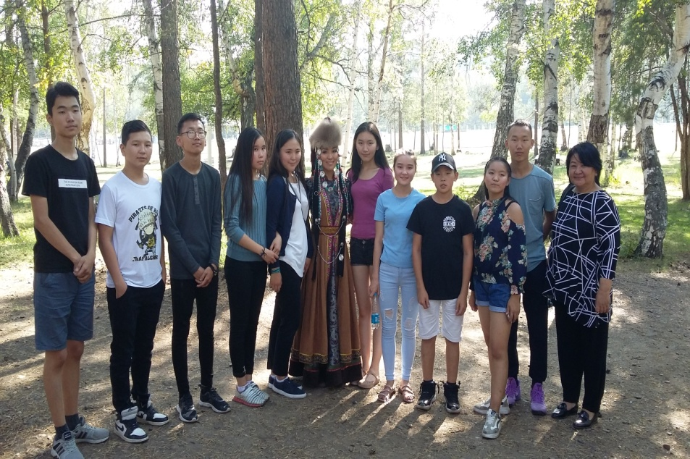
Student Life

Slide 7
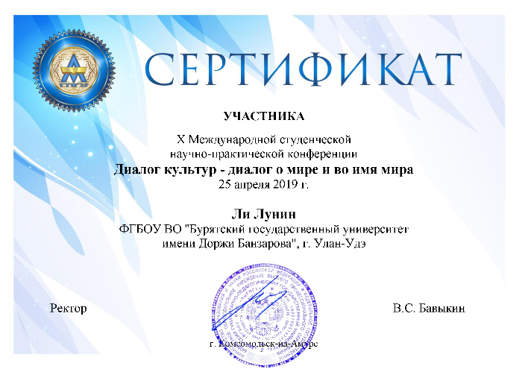
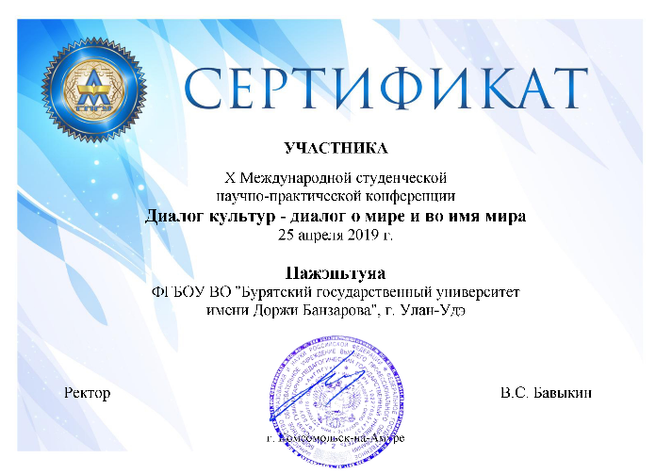

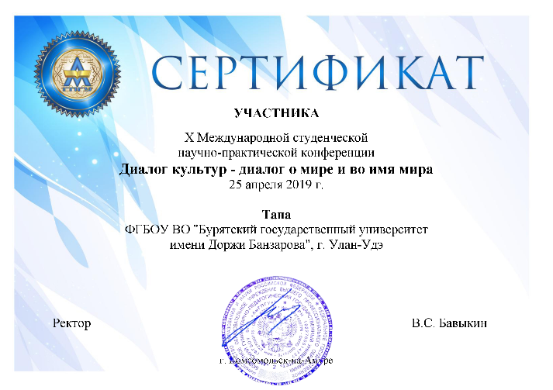
Our students participate in various conferences

Slide 8

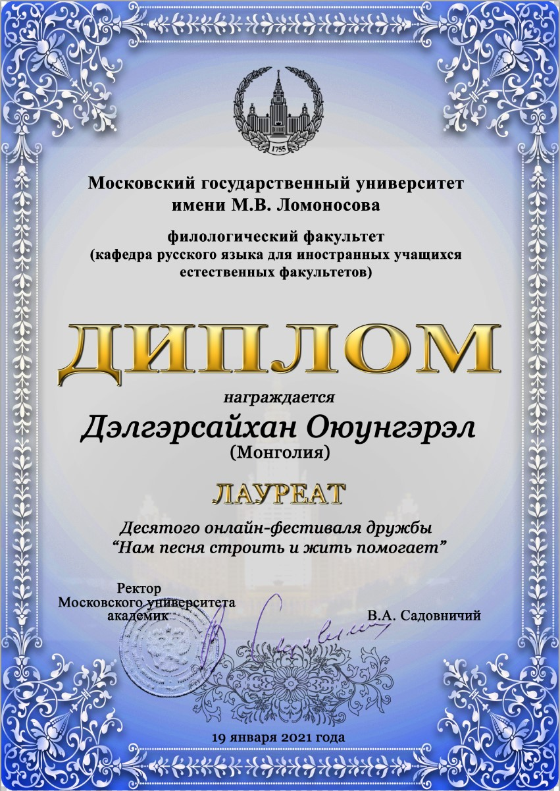
Our students participate in various festivals

Slide 9
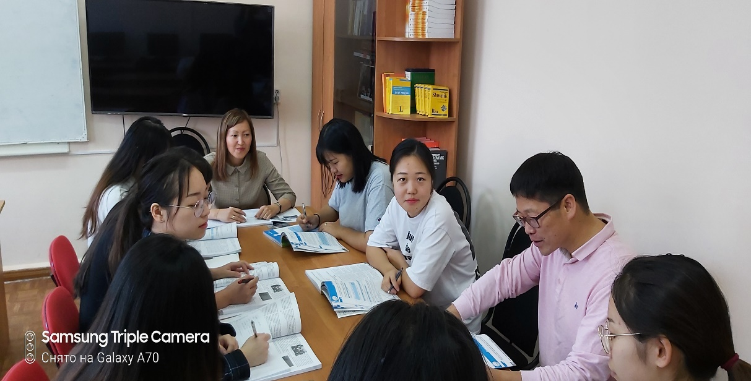
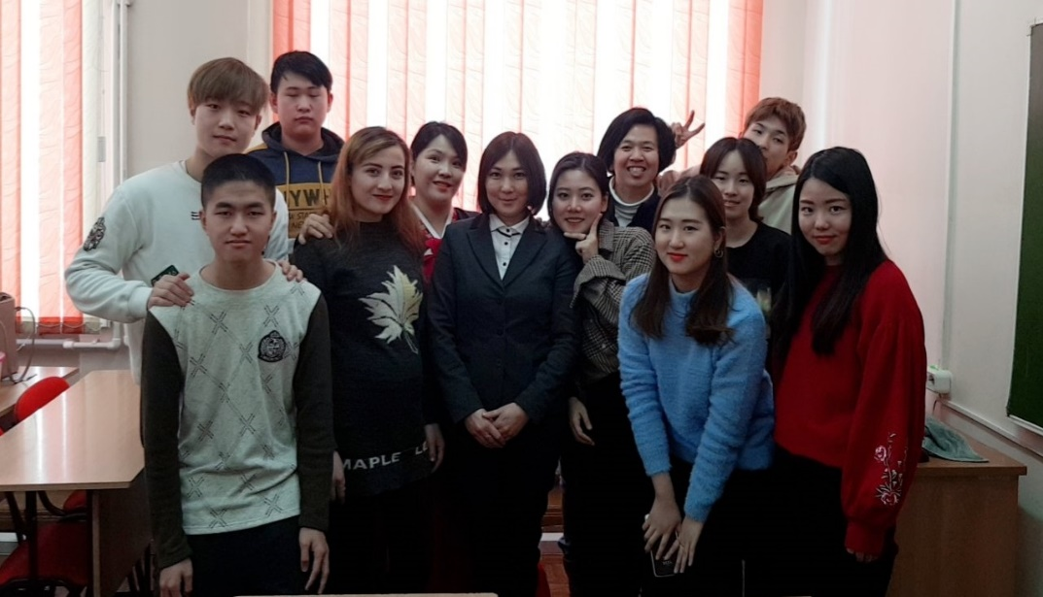
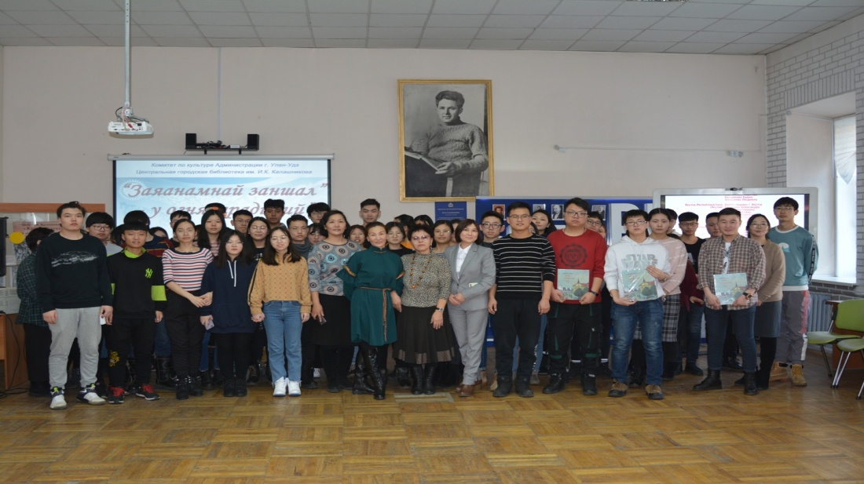

Slide 10
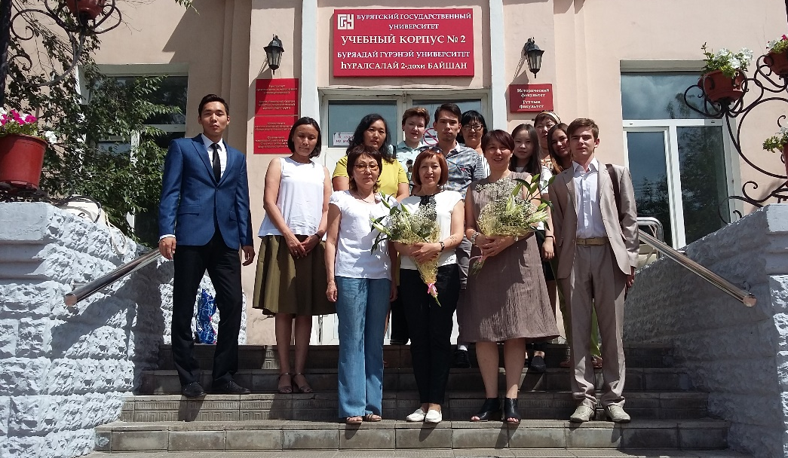
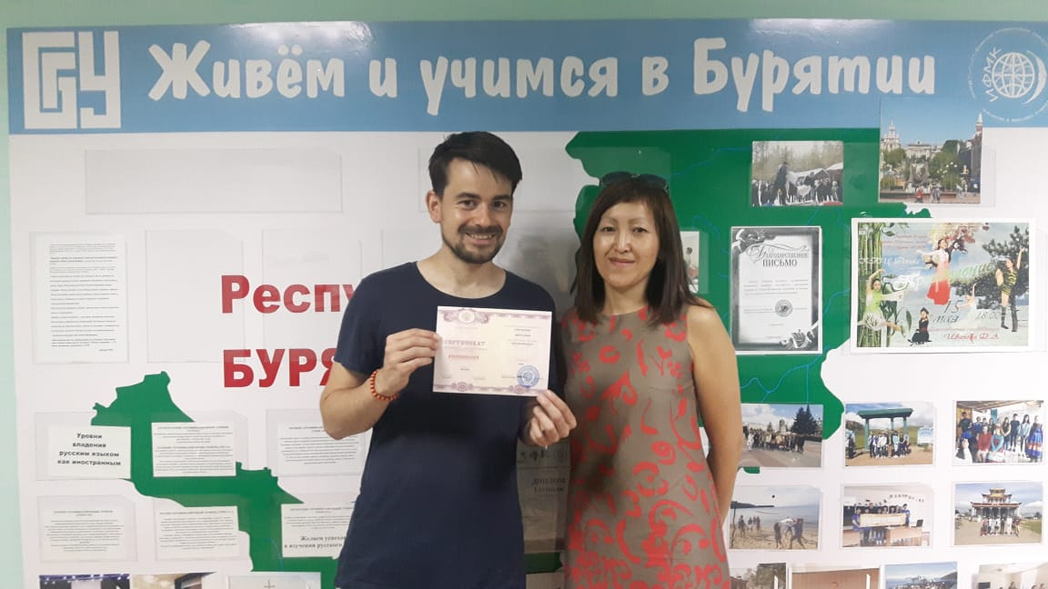
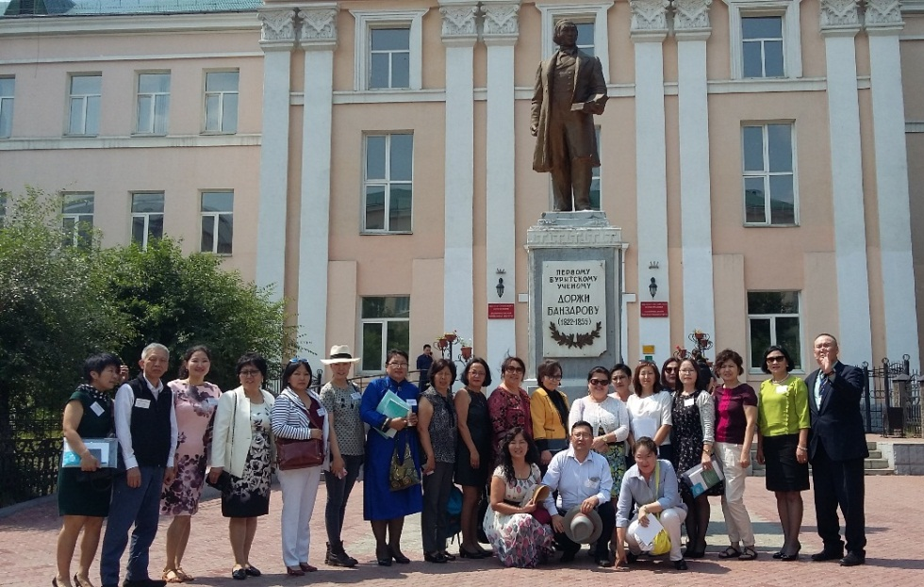
Our students of refresher courses, professional retraining, training for testing

Slide 11
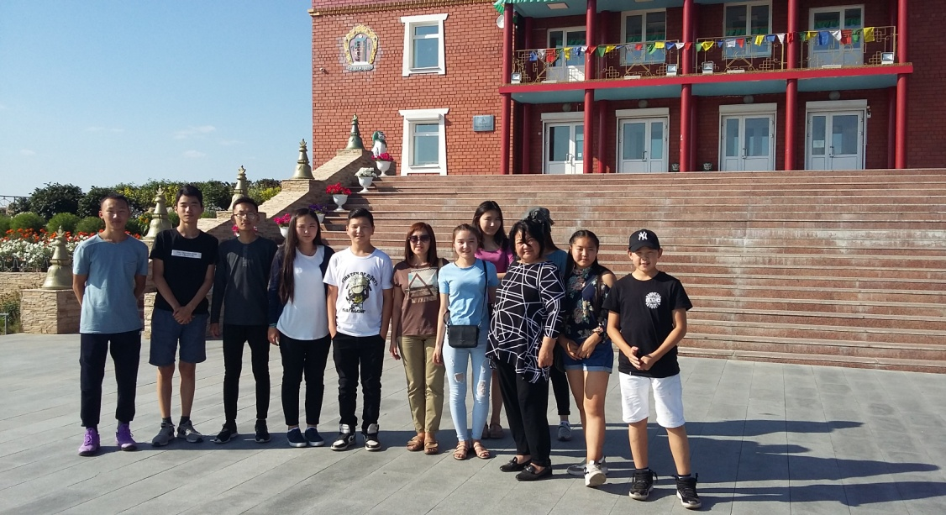
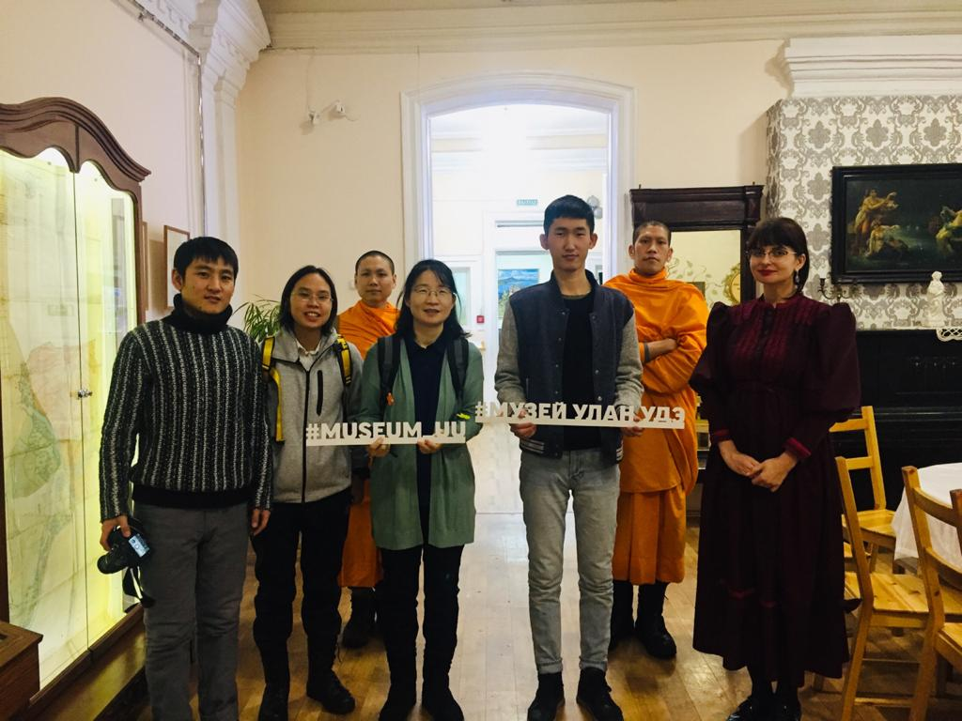
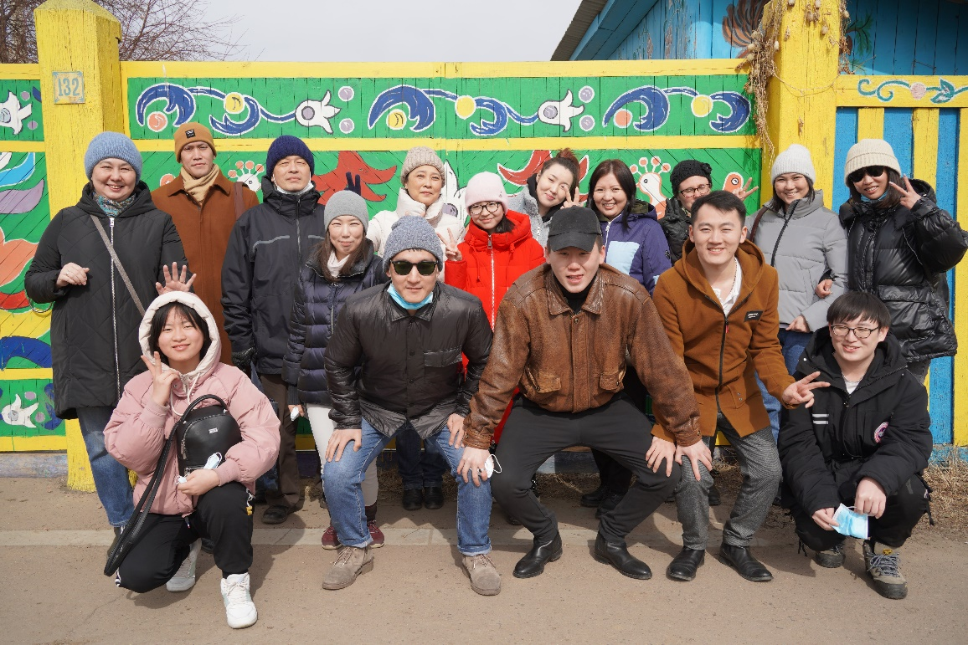
Our excursions and trips

Slide 12
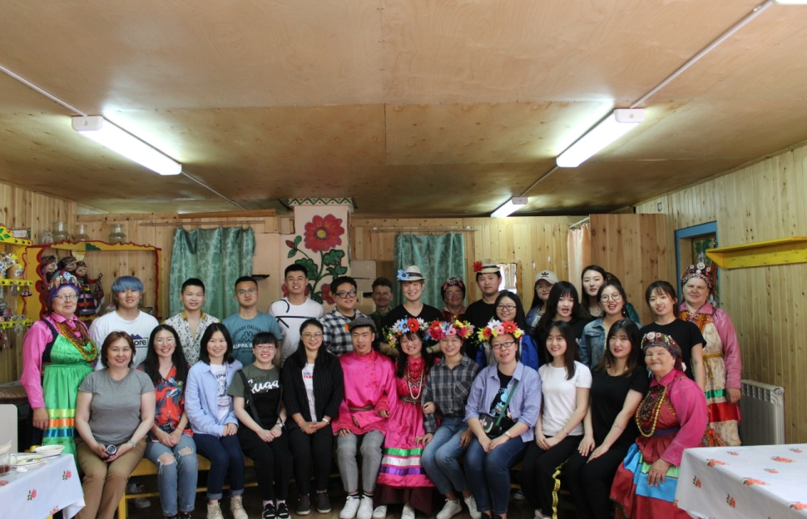
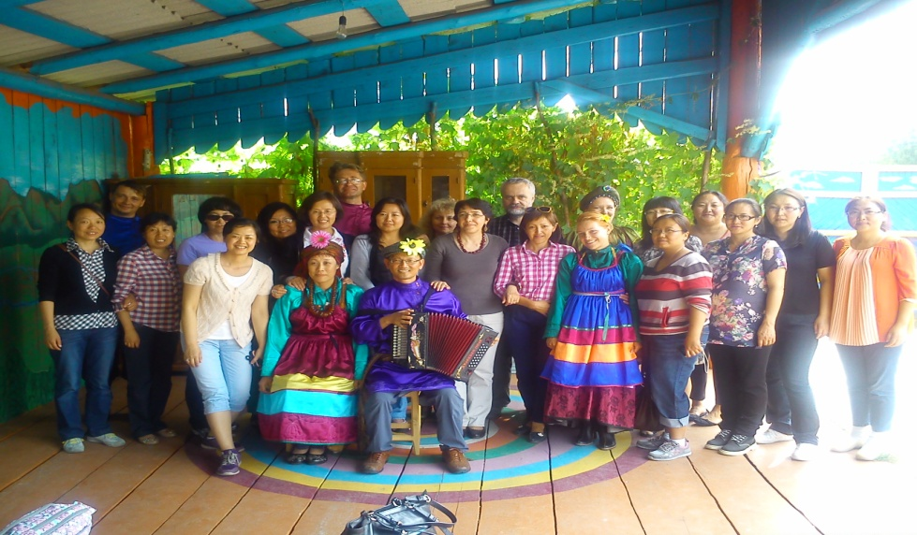
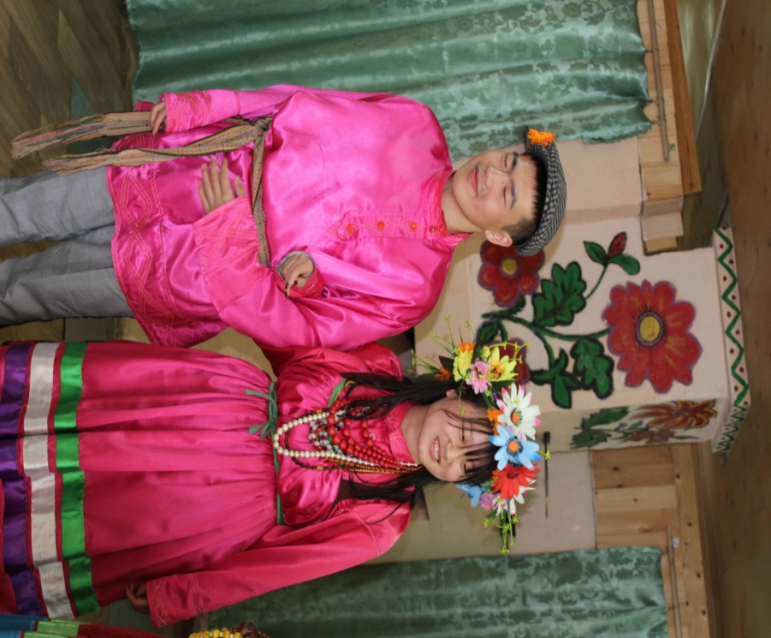
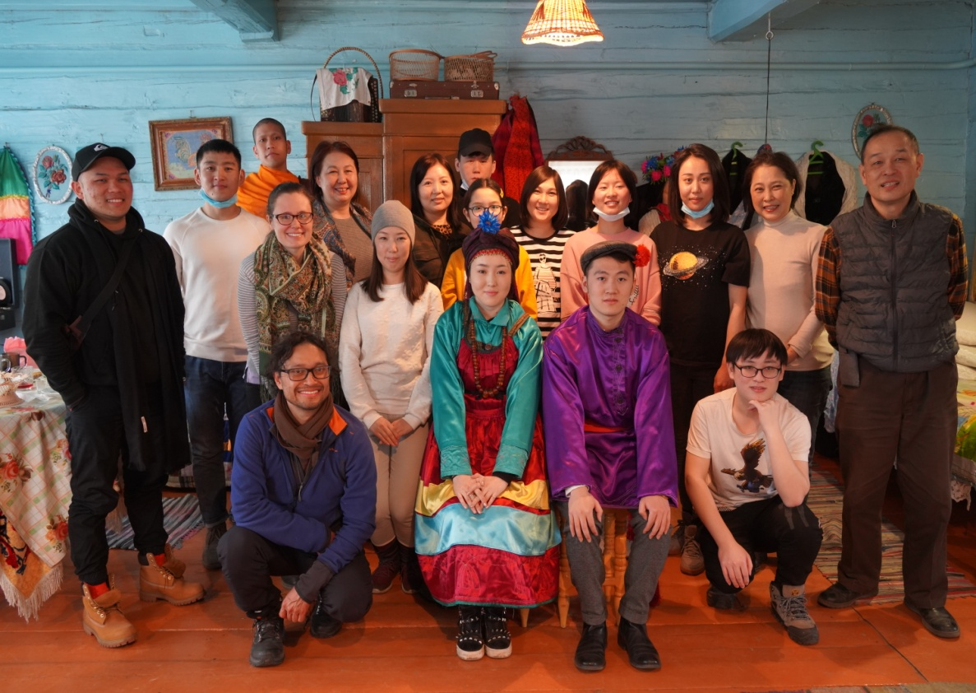
"Visiting the Old Believers"

Slide 13
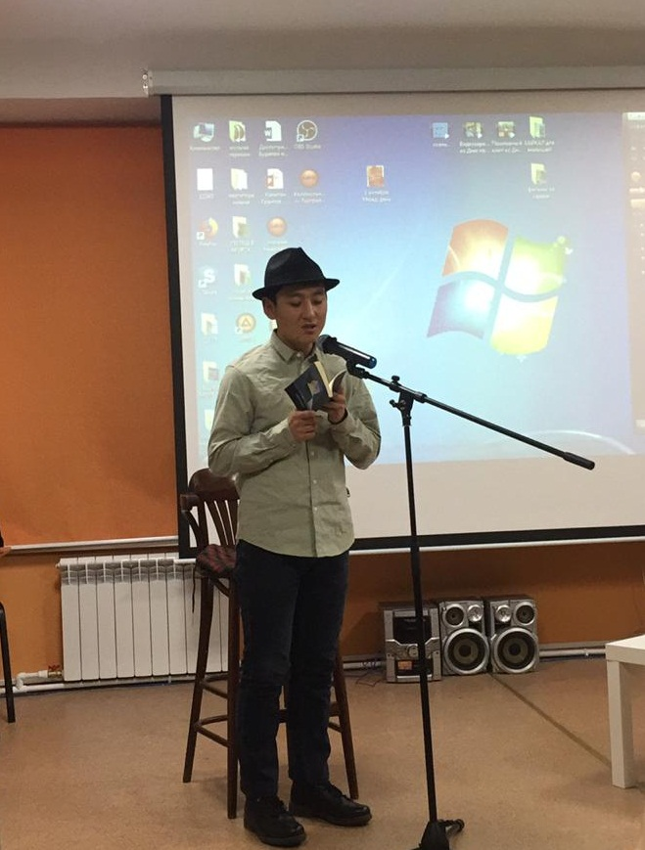
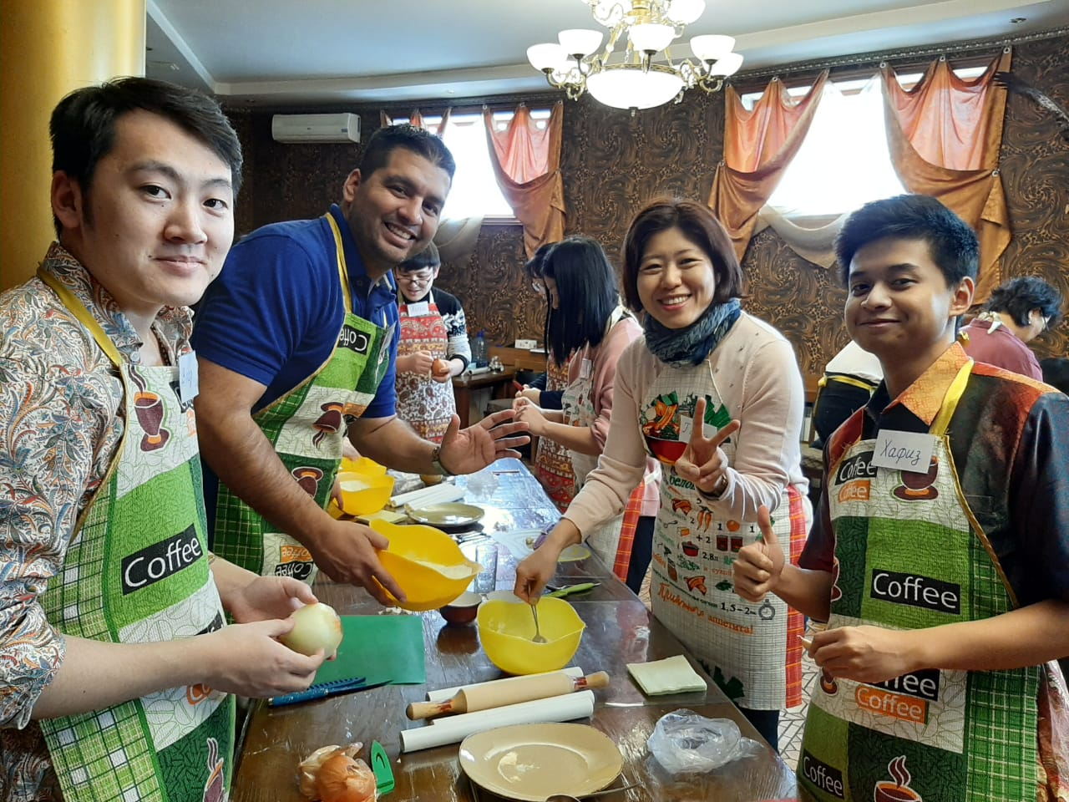
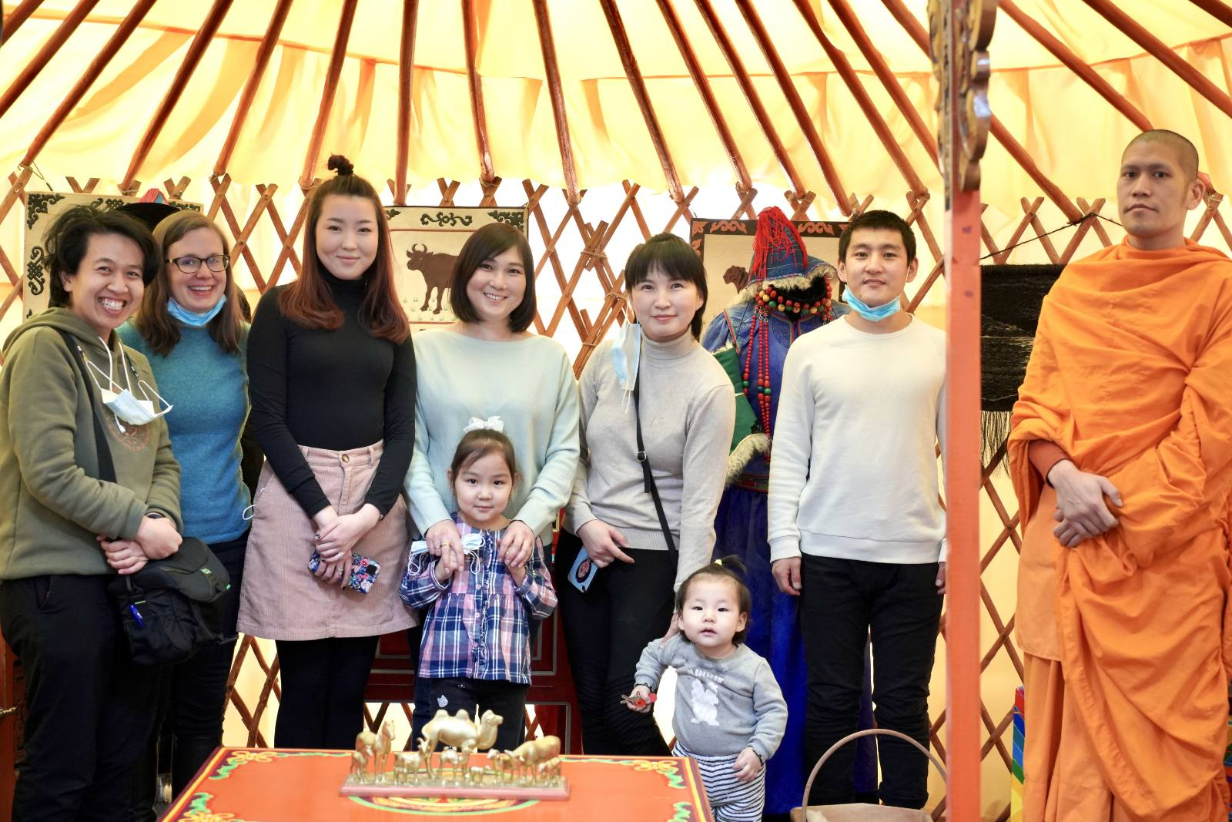

Slide 14
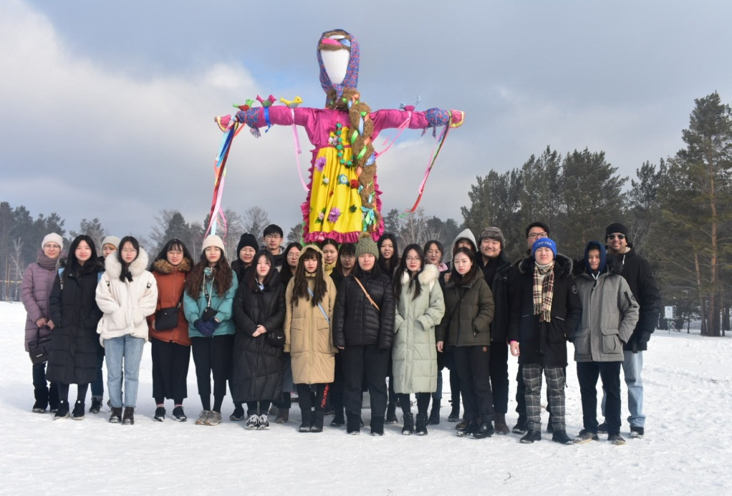
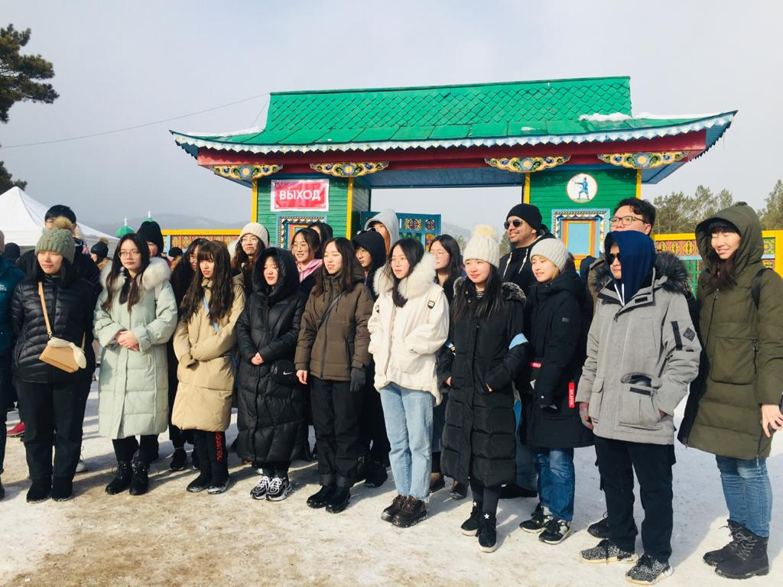
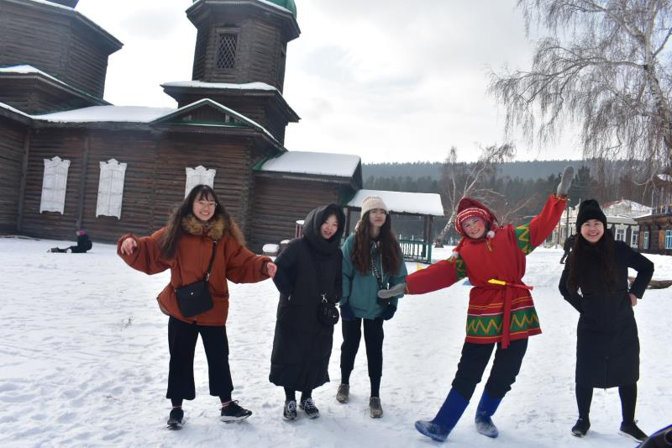

Slide 15
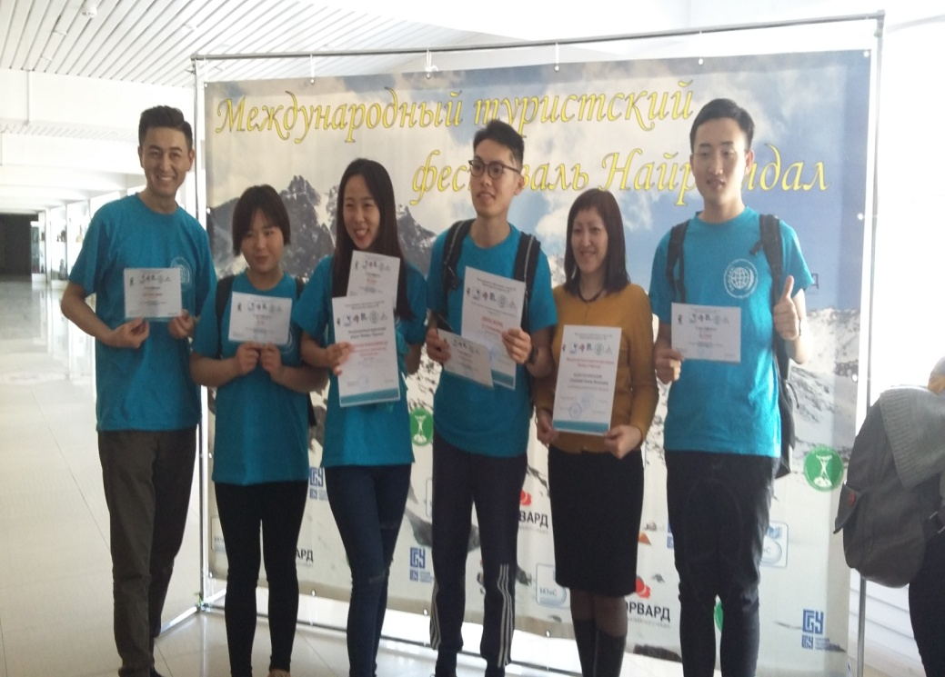
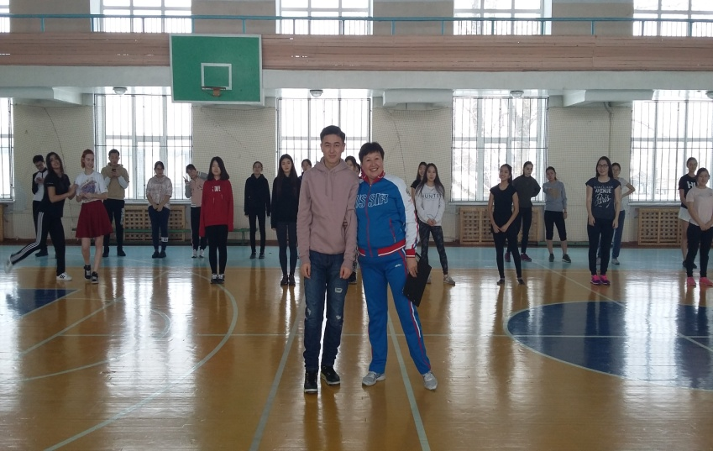
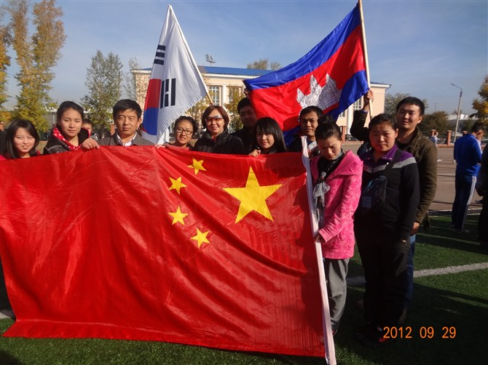
Our students have achievements in sports

Slide 16
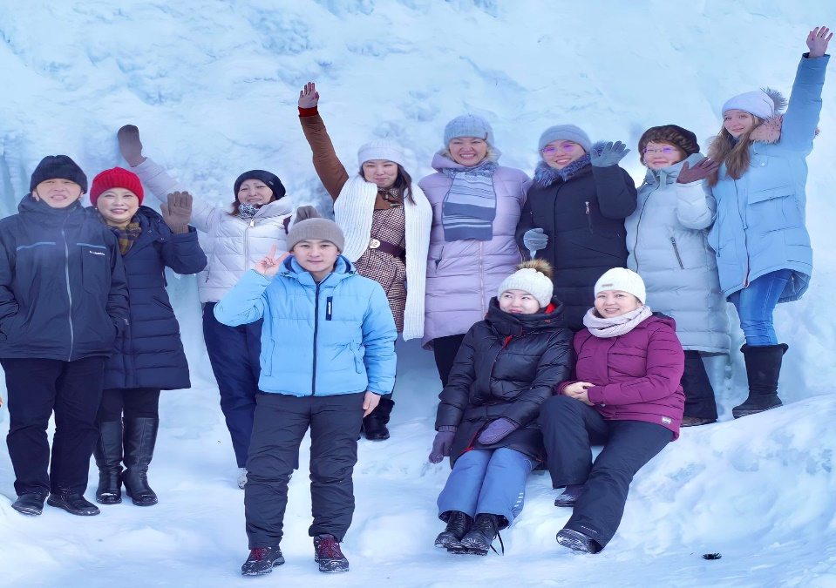
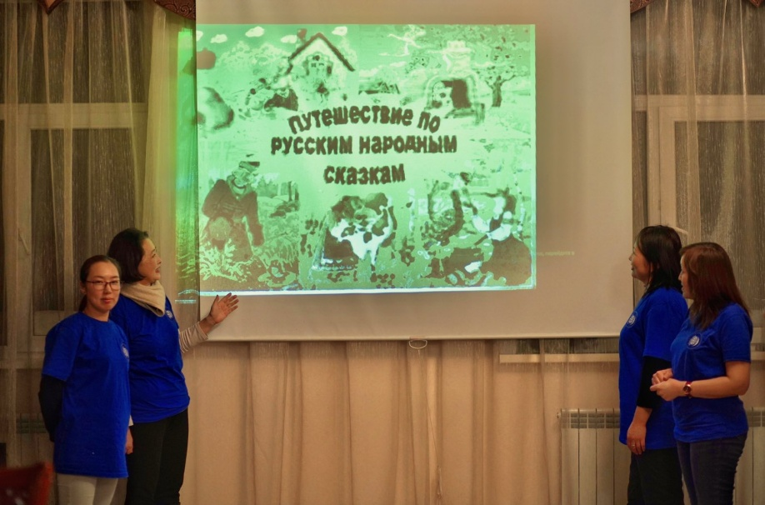
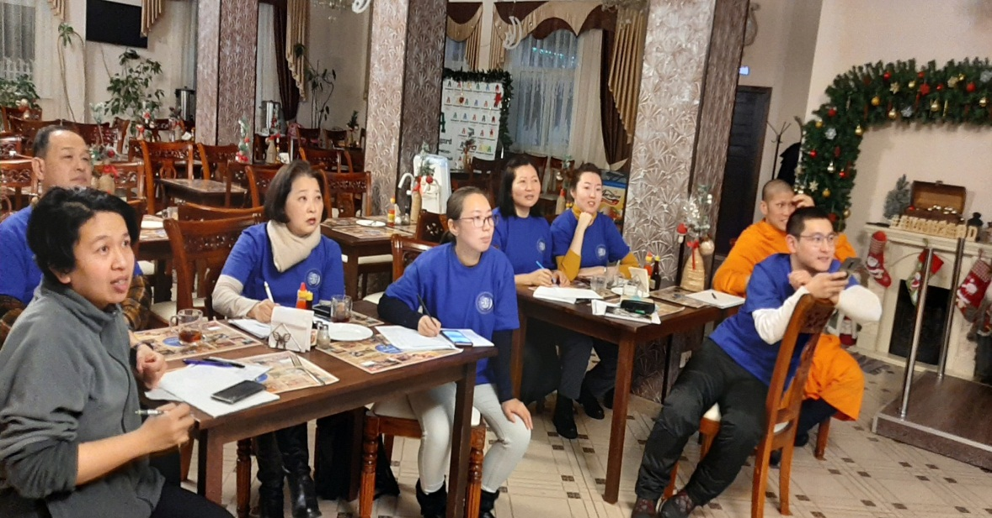
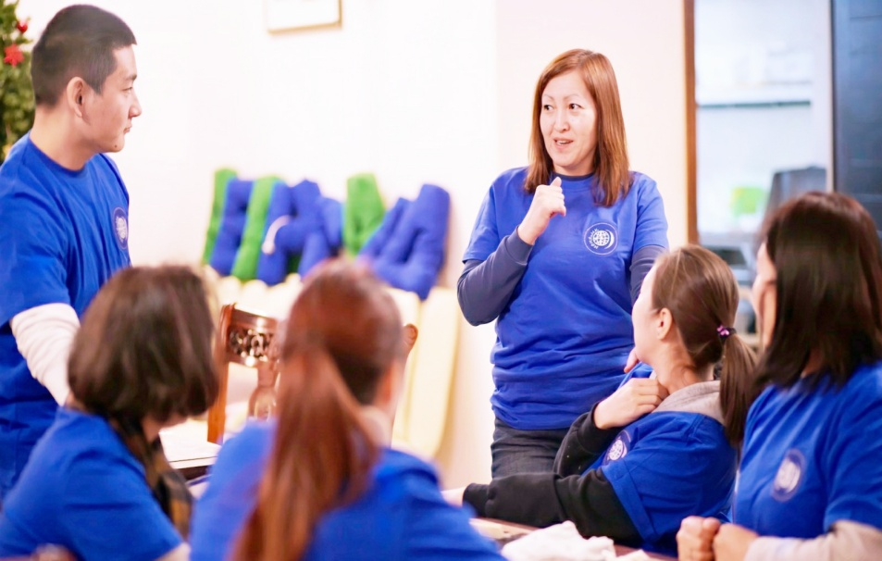
Baikal Winter School

Slide 17

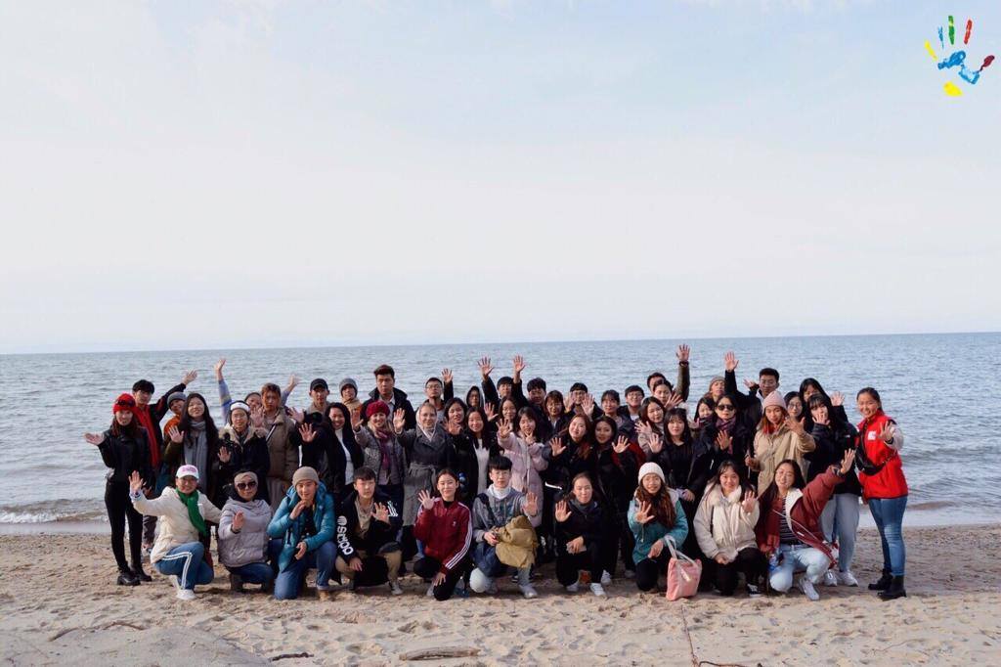
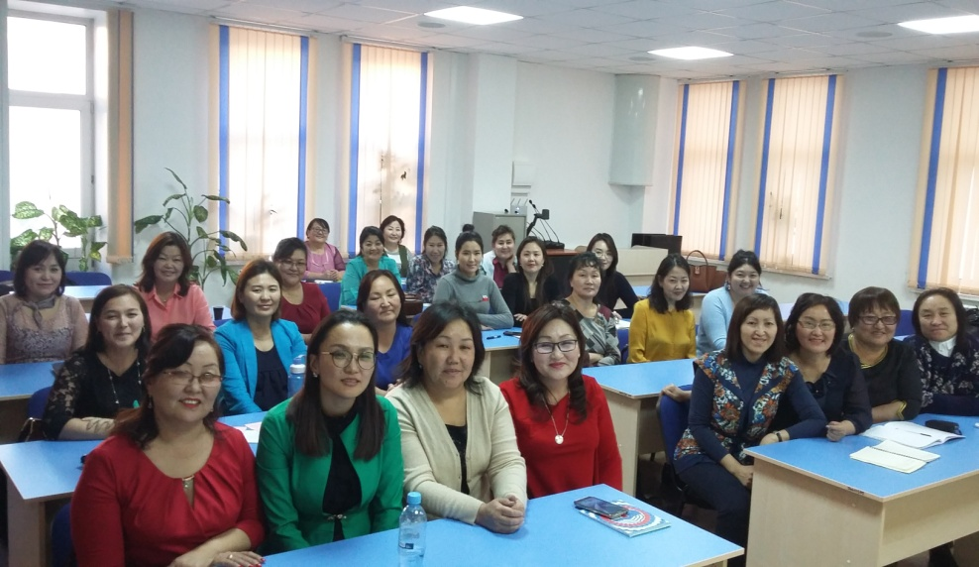
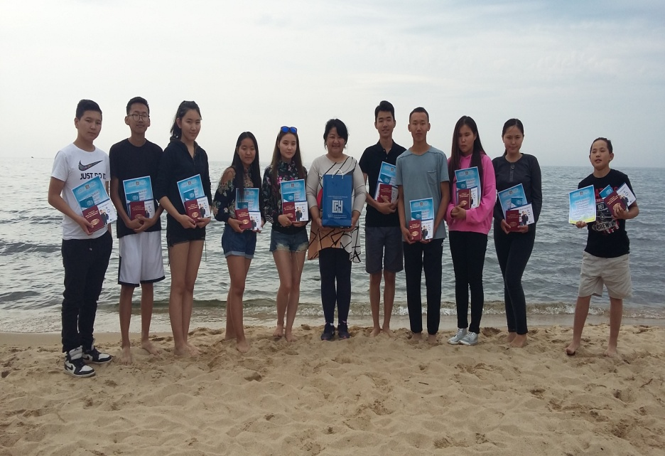
Baikal Summer School

Slide 18
The quickest, most effective and funniest way to learn a language is to visit the country where the language is spoken. It is better to study Russian in Russia!
We invite you to study at Buryat State University in Ulan-Ude - the capital of sunny and hospitable Buryatia!

Slide 19
